Slide 1
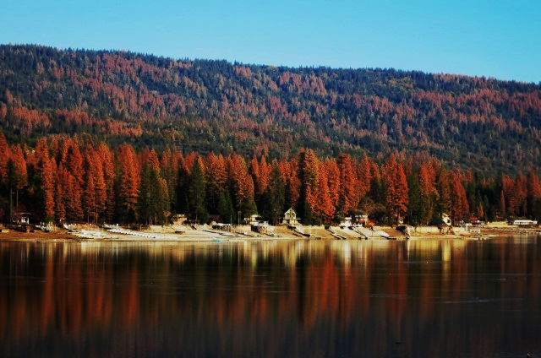
Addressing Tree Mortality
Strategy for the Future

Slide 2
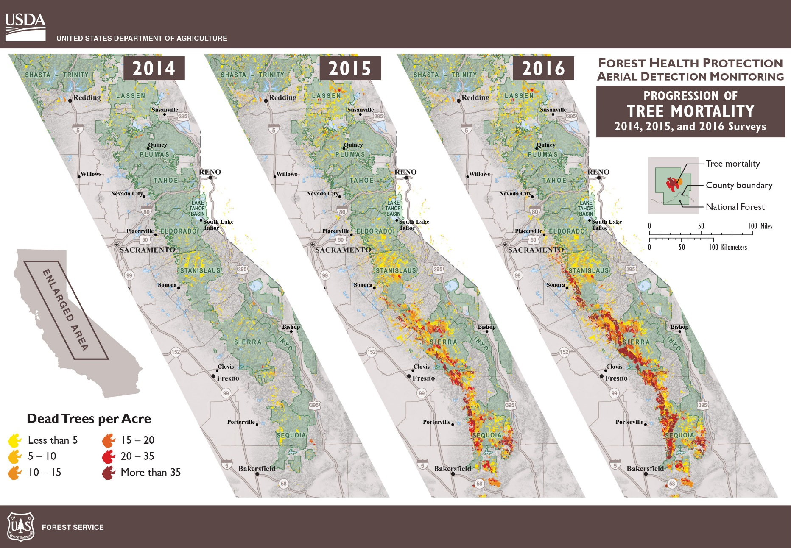

Slide 3
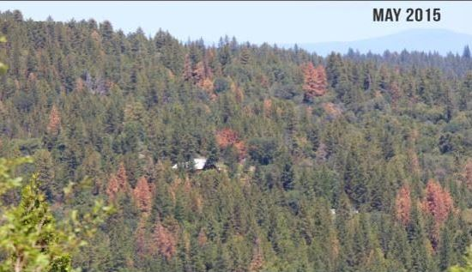

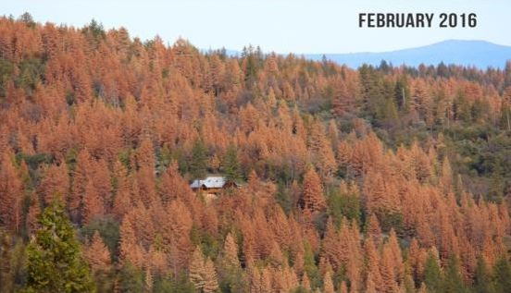

Slide 4
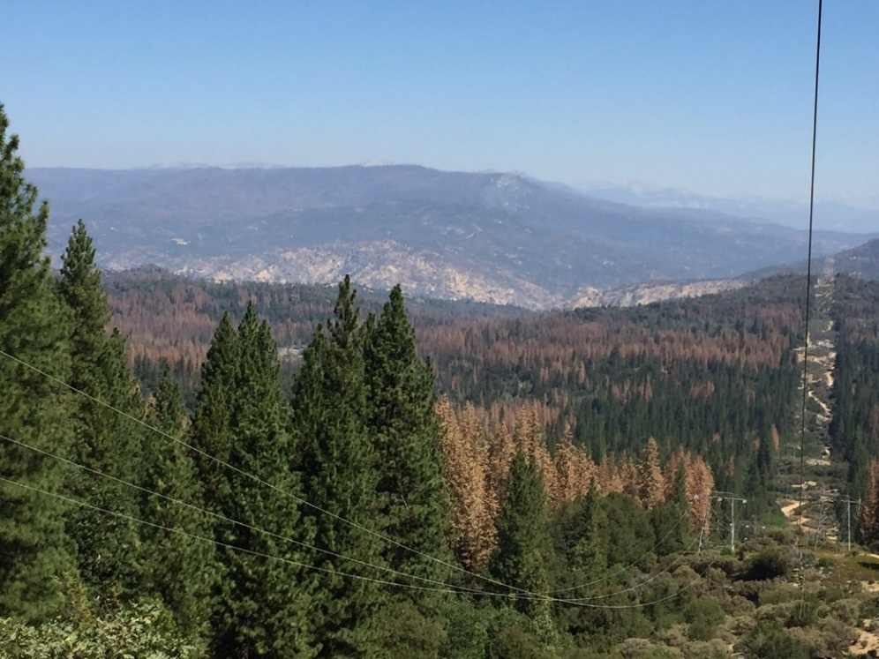
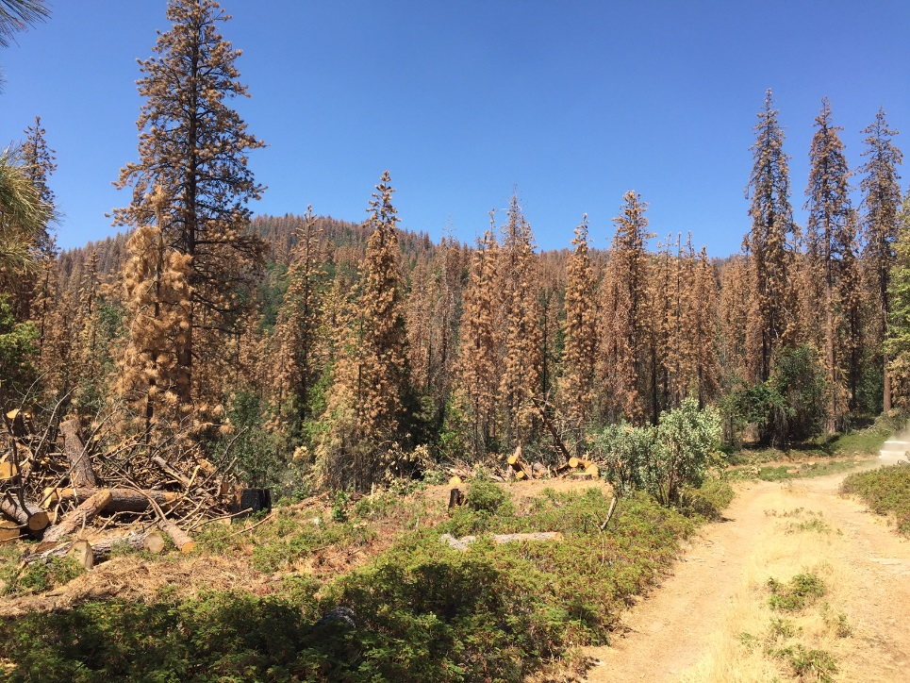

Phase I – Triage of High Hazard Areas
Tree mortality in the southern Sierras extends across 3.5 million acres from Lake Tahoe to Kern county and affects over 400,000 acres or 40% of the Sierra National Forest.
In an elevational band from 3000 to 5500 ft. the Sierra National Forest has lost over 80% of our ponderosa and sugar pines larger than 20 inches in diameter.

Slide 5
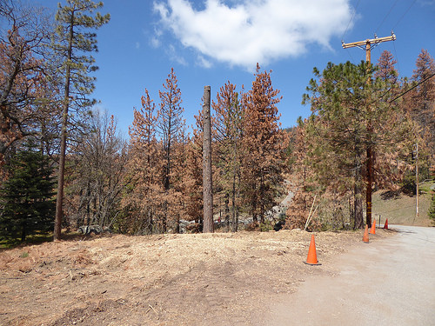
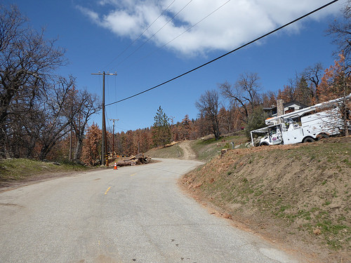
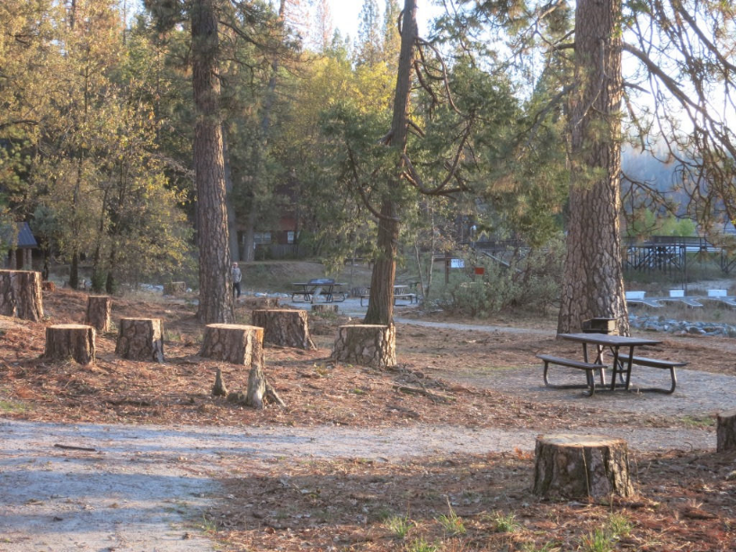
Emphasis of Hazard Tree Removal
As of Sept 2017 Forest Service has removed trees along 748 miles of roads, in 324 recreation sites, around 135 communities, and as of Dec. 2016 1,375 acres of fuel breaks on 6 forests in 10 counties..

Slide 6
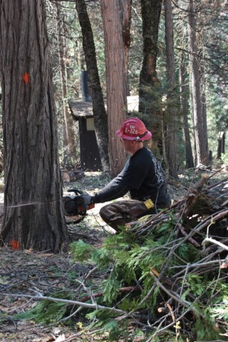
Increasing Public Safety
The response strategy is divided into three phases:
Phase I is to remove dead and dying trees in high hazard areas to protect public and employee safety from falling trees and wildfire risk.
Phase I - focused on campgrounds and other forest recreation sites, roads, trails and utility corridors, and helping protect communities from wildfire risk

Slide 7
Phases II & III
 | Affected Areas |  | Unaffected Areas
 | Hazard Areas Tier 1 | Hazard Areas Tier 2
Phase I | Fell/Remove dead and dying trees | -- | Continue planned ecological restoration work
Phase II | Treat fuel loads caused by dead/down trees | Remove dead/dying trees
Phase III | Restore treated lands, including reforestation where appropriate | Treat fuel loads caused by dead/down trees
Phase II
Treat hazardous fuels conditions
Remove dead and dying trees in lower-risk areas
Phase III
Restoration opportunities including reforestation

Slide 8
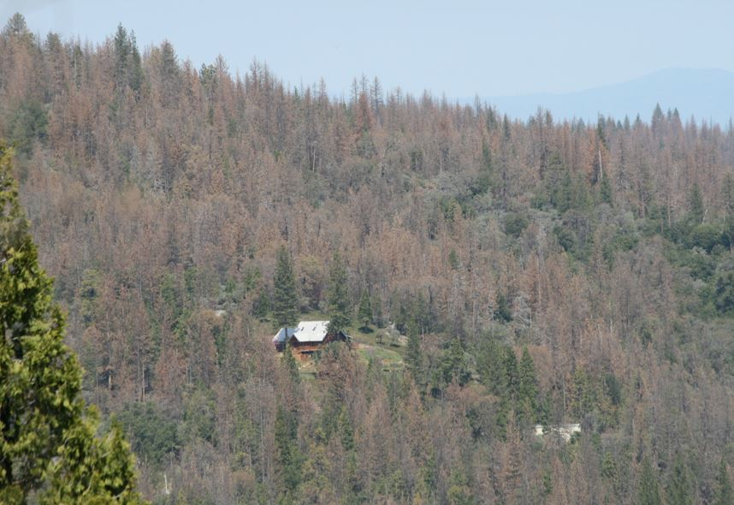
Phase II – Recovery- treating dead and down fuels
Notice how few green trees are left?

Slide 9
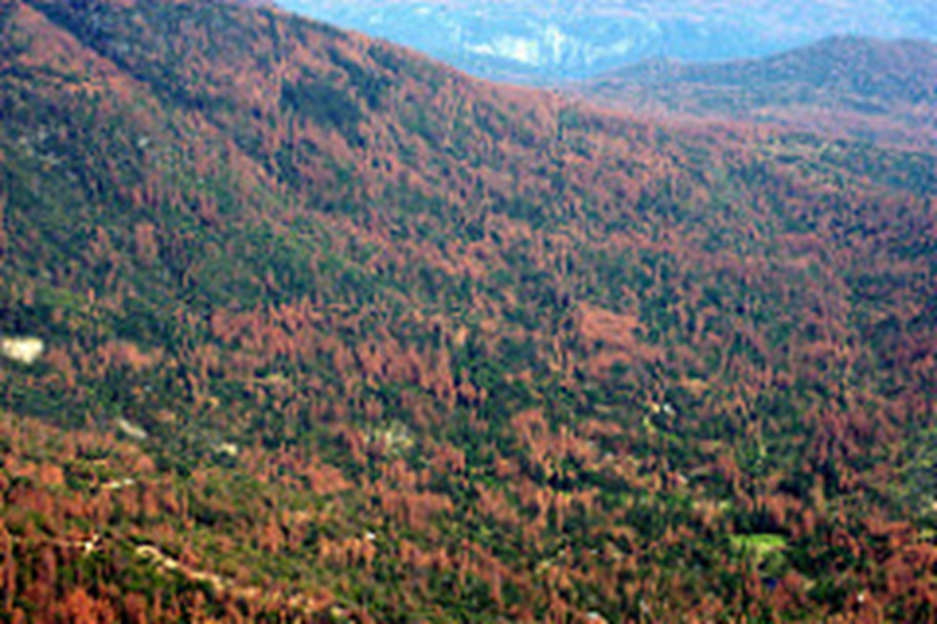

Slide 10
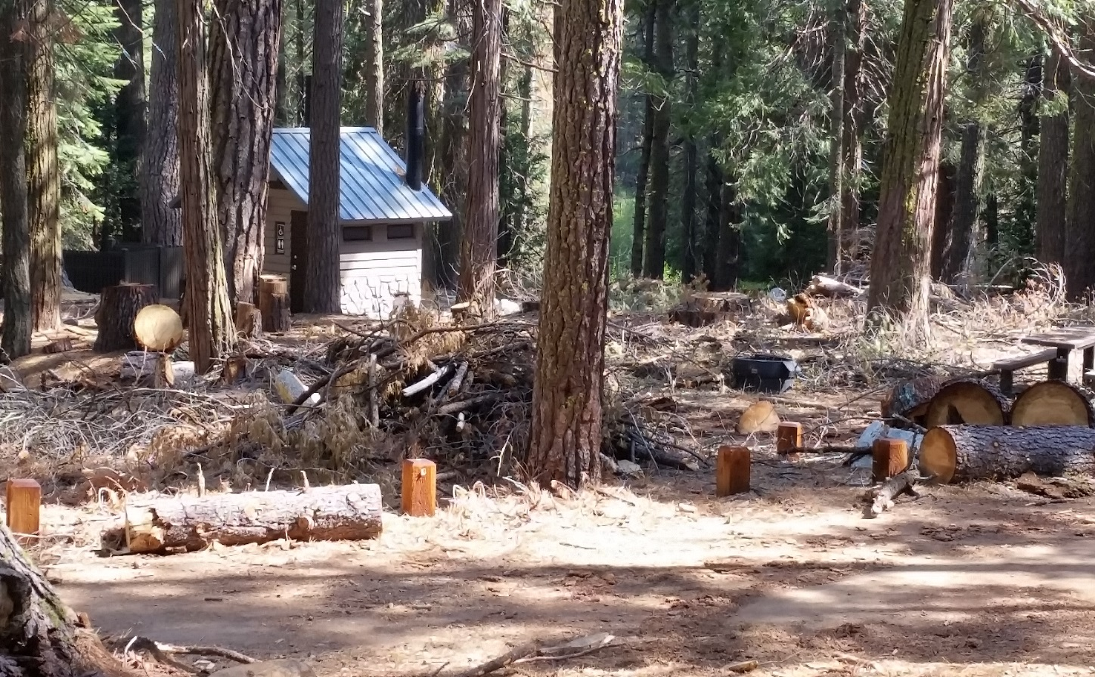
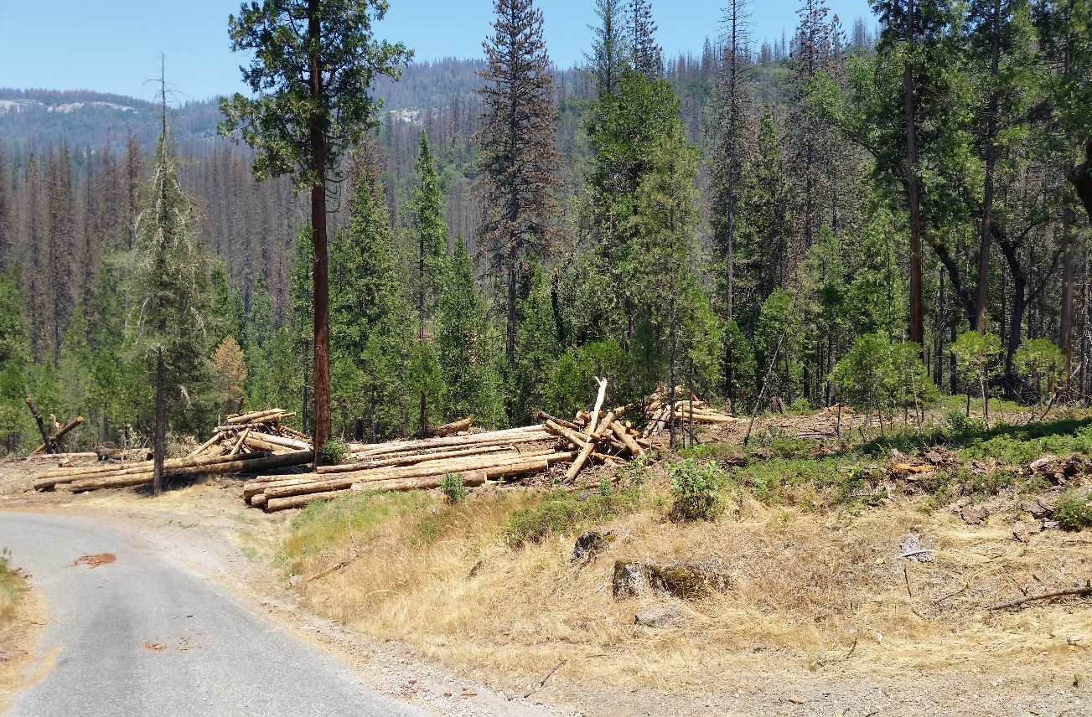
Wildfire Risk Reduction

Slide 12
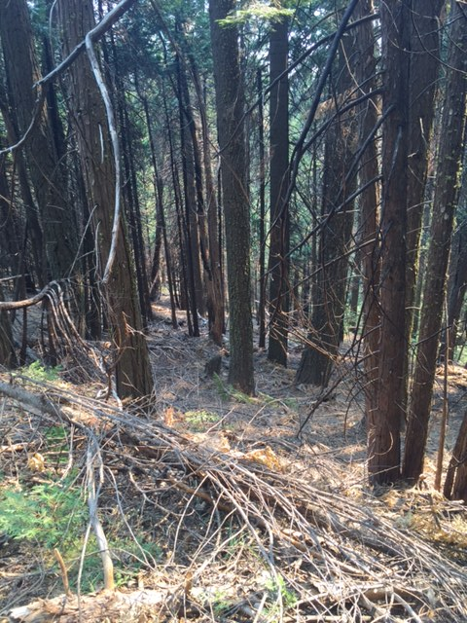
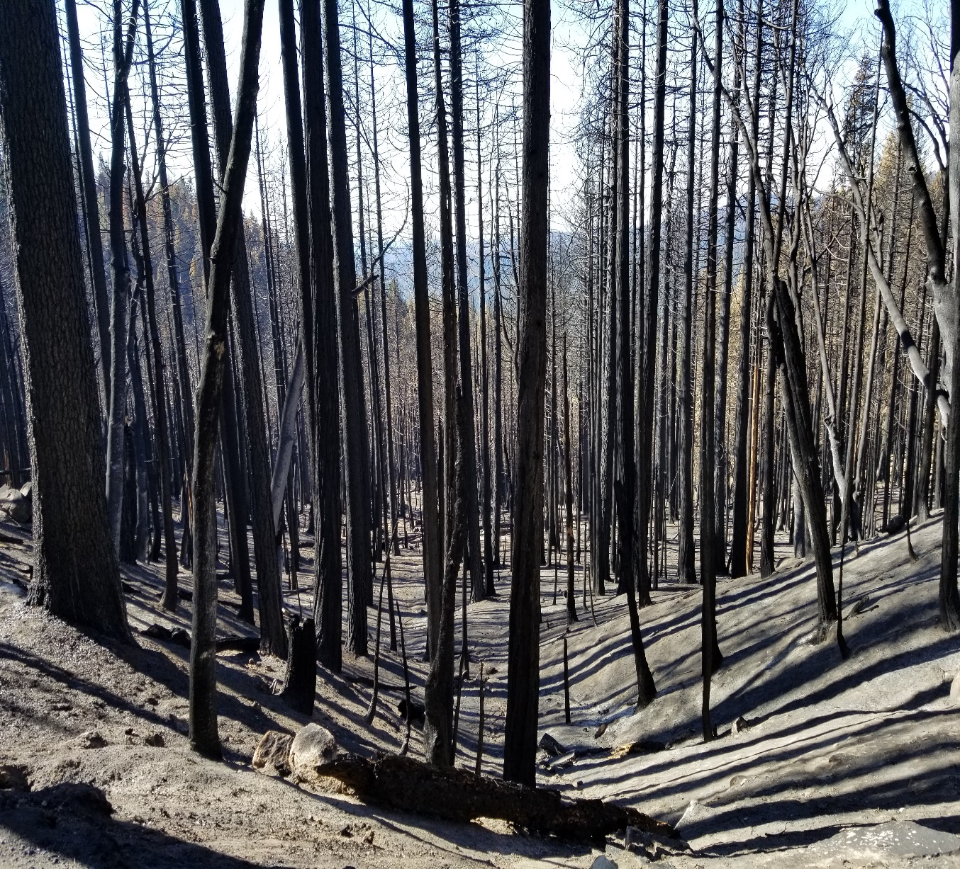
Railroad Fire 2017 - Before and After

Slide 13
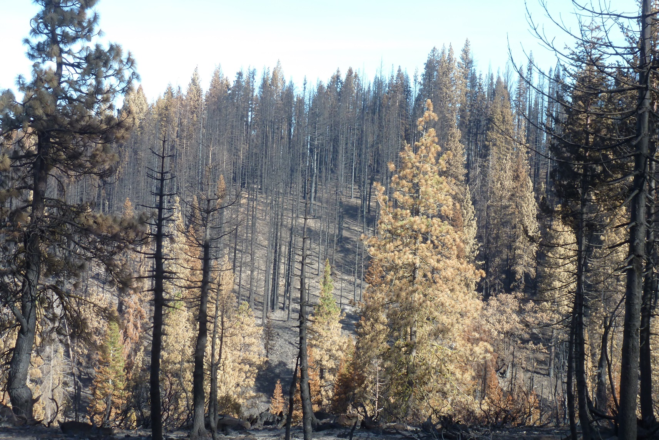
Phase III - Recovery
How do we protect existing
green trees from
uncharacteristic wildfire
and provide future
habitat?

Slide 14
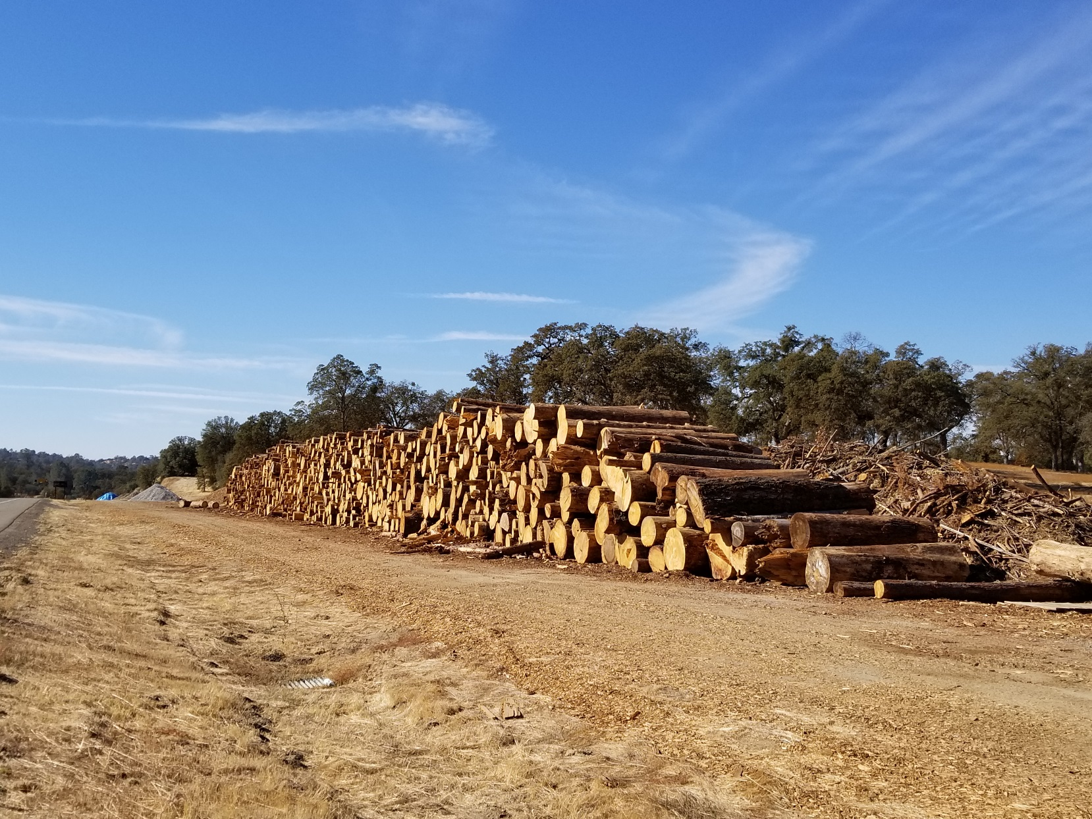
Phase III - Recovery
Tools for Recovery:
Increase efficiencies for
mechanical removal of
biomass where
opportunities exist.

Slide 15
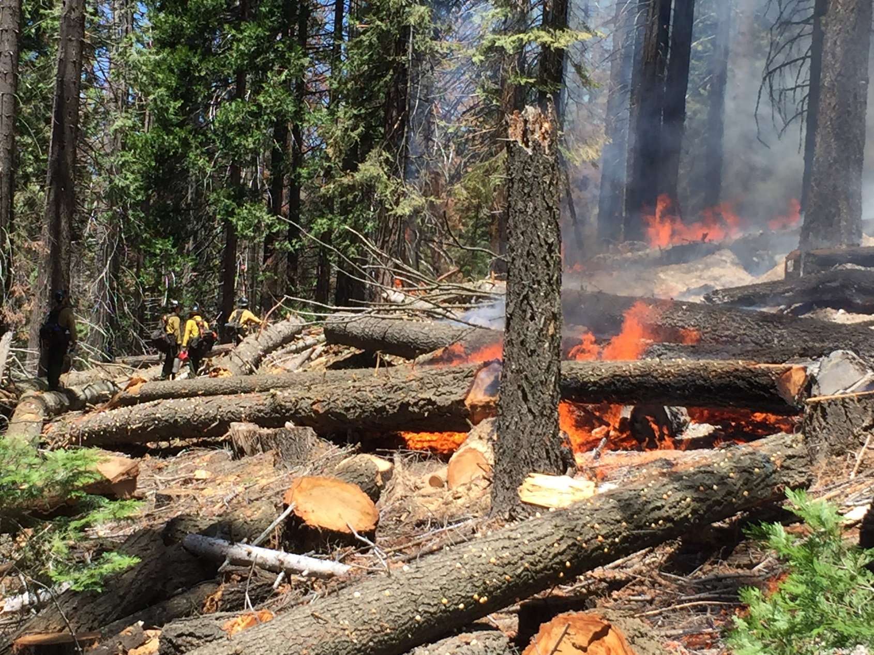
Phase III - Recovery
Tools for Recovery (cont.):
Use management ignited
(prescribed) fire for
wildfire risk reduction.

Slide 16
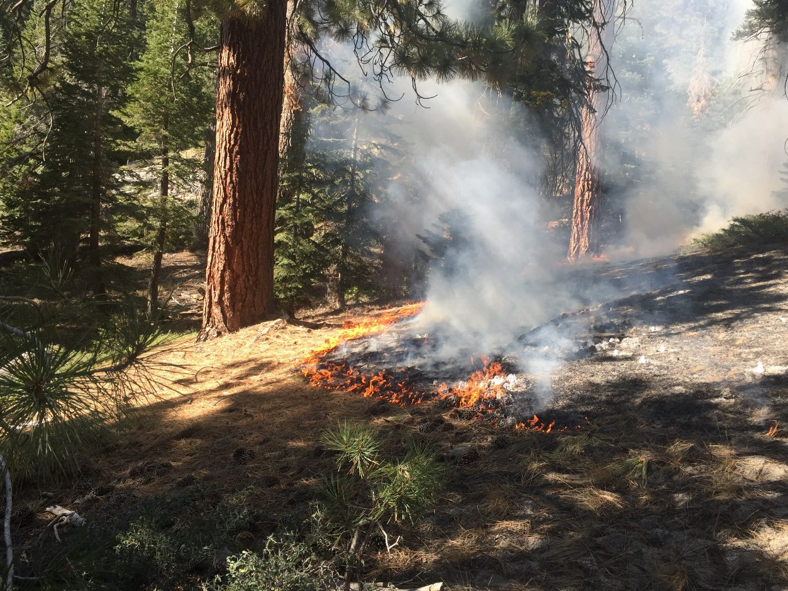
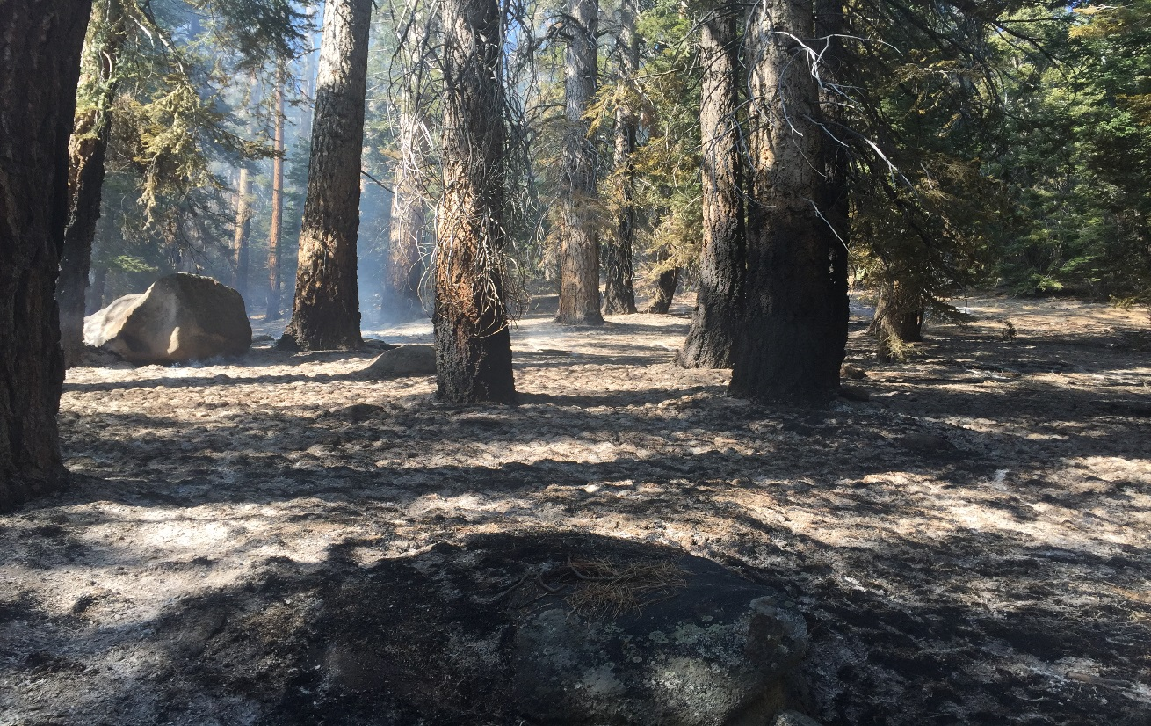
Phase III - Recovery
Tools for Recovery:
Manage naturally ignited fire
whenever and wherever feasible to
reduce hazards and improve resiliency to climatic change and stochastic events.

Slide 17
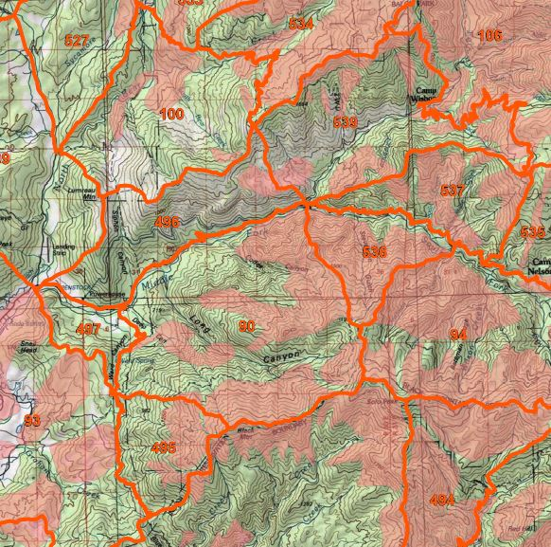
Phase III - Recovery
Potential wildland fire Operational Delineations -PODs

Slide 18
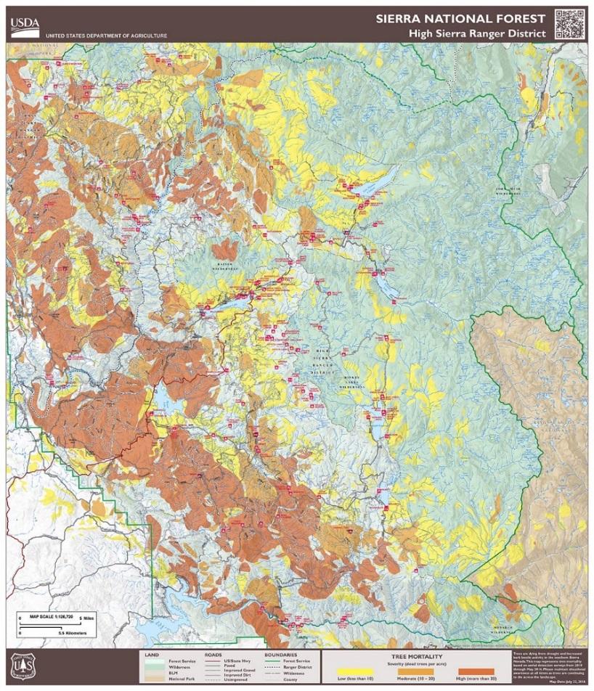
Lessons Learned and Objectives
Lessons Learned:
We have to rethink our firefighting tactics in and adjacent to standing dead trees to provide firefighter safety.
The current condition is not static and the dynamics of identifying the risk and exposure of employees and the public is changing rapidly.
Small changes in environmental conditions can affect big changes in exposure to unstable trees.
Give our first responders better tools to identify High Hazard areas and gain situational awareness during fire operations.
Tree Mortality Maps concentration are available for Smart device Avenza typeuse for the 3 southern Sierra Nevada NFs. Forests can copy and distribute hard copies for personnel without smart devices. ‘POD’ maps (Potential wildland fire Operational Delineations) with created with input from field fire leaders Tree Mortality Maps and ‘POD’ boundaries in WFDSS ‘Cover book’ tree mortality information for use by out of area resources and in briefing teams. Process to obtain and distribute Local government identified Evacuation routes

Slide 19
Lessons Learned and Objectives
Objectives:
Nested PODS: identify PACE (Primary, Alternate, Contingency and Emergency boundaries), in extreme weather consider PODs and strategies that build success rather than firelines that cannot be held or increase firefighter risk and exposure.
Use PODs for risk assessment (Go/No Go decision tree) for naturally ignited wildfires and give our first responders the ability to make the necessary decisions at the onset of fires.
Pre-identify where risk reduction opportunities exist to protect green assets for future utilization and from the threat that tree mortality poses.
Tree Mortality Maps concentration are available for Smart device Avenza typeuse for the 3 southern Sierra Nevada NFs. Forests can copy and distribute hard copies for personnel without smart devices. ‘POD’ maps (Potential wildland fire Operational Delineations) with created with input from field fire leaders Tree Mortality Maps and ‘POD’ boundaries in WFDSS ‘Cover book’ tree mortality information for use by out of area resources and in briefing teams. Process to obtain and distribute Local government identified Evacuation routes

